Slide 1
Nagarro Group Q3 2025 Executive Business Presentation
Nagarro Group

Slide 2
Executive Summary
2 / 11
Notes:
This section provides a high-level overview of Nagarro's financial performance in Q3 2025, highlighting key growth metrics and financial achievements.

Slide 3
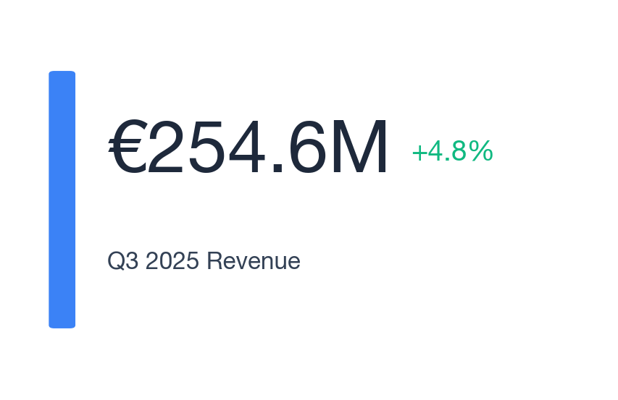
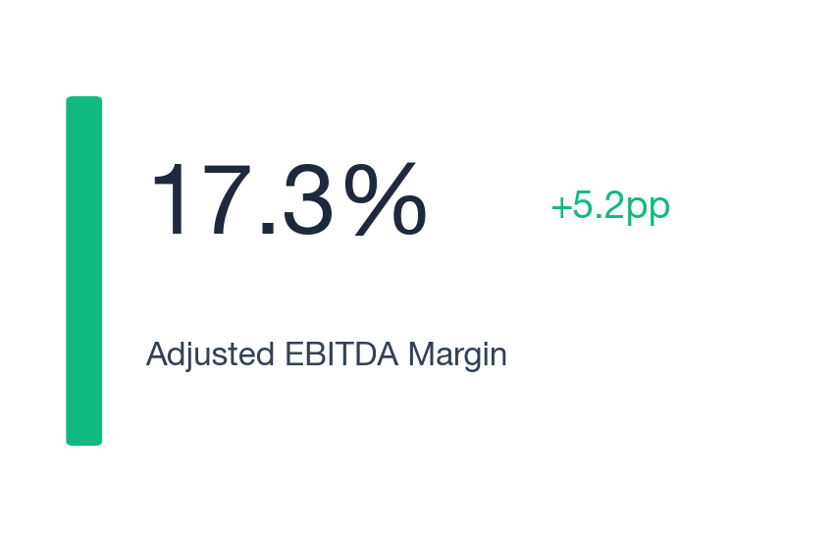
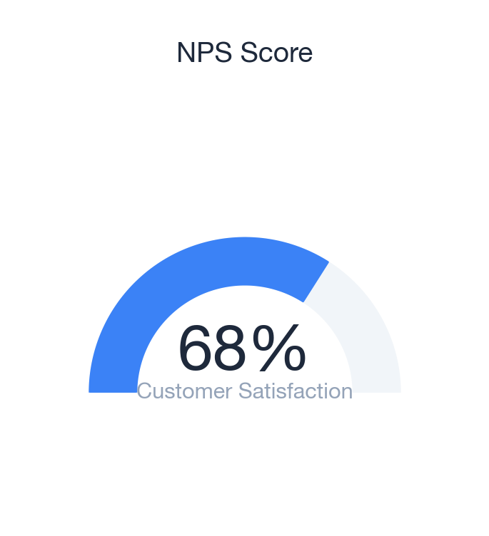
Key Financial Metrics Dashboard
3 / 11
Notes:
This dashboard presents key financial indicators for Q3 2025, emphasizing revenue growth, EBITDA margin improvement, and customer satisfaction metrics.

Slide 4
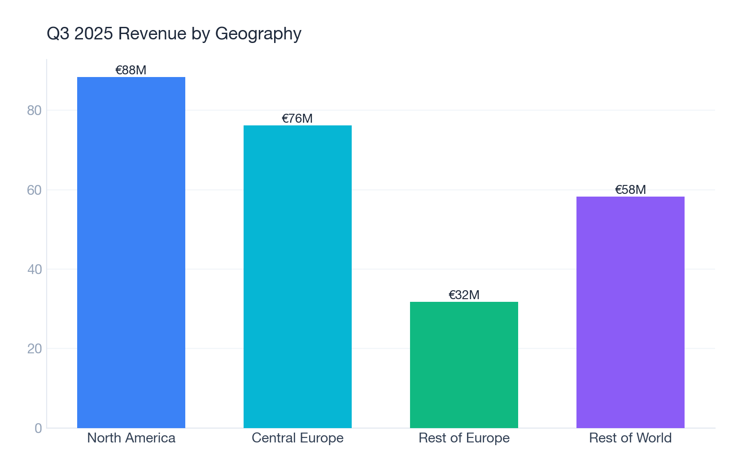
Revenue by Geography: Central Europe Leads
KEY INSIGHTS
Central Europe revenue up 11% YoY
4 / 11
Notes:
Central Europe showed the strongest growth in Q3 2025, driven by increased demand in key sectors.

Slide 5
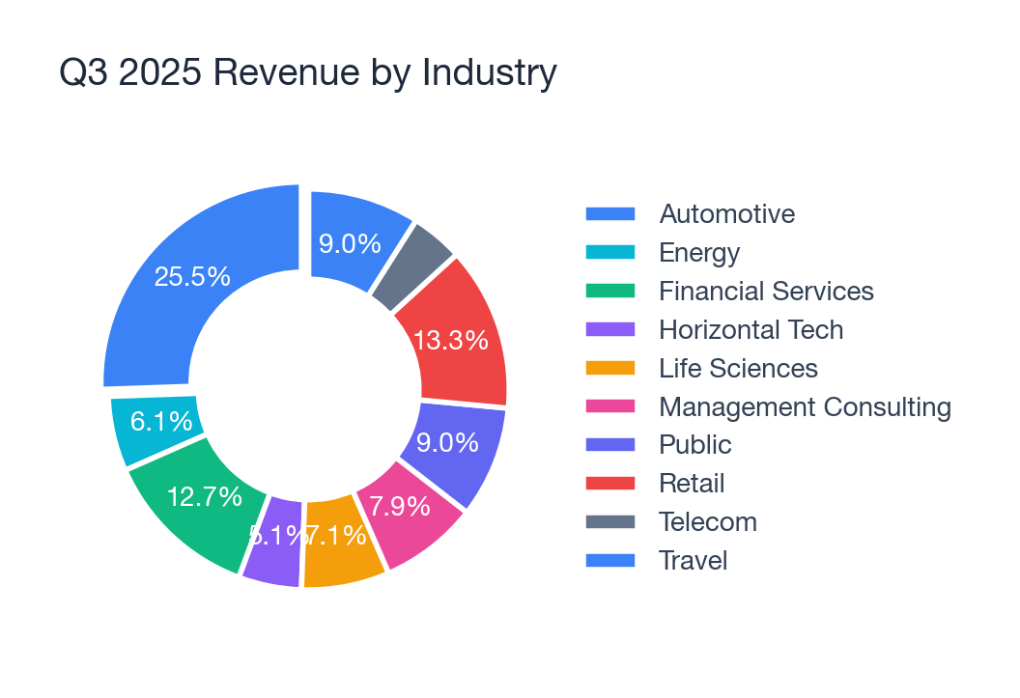
Revenue by Industry: Management Consulting Surges
KEY INSIGHTS
30.1% growth in Management Consulting
5 / 11
Notes:
Management Consulting and Business Information saw significant growth, highlighting the demand for strategic advisory services.

Slide 6
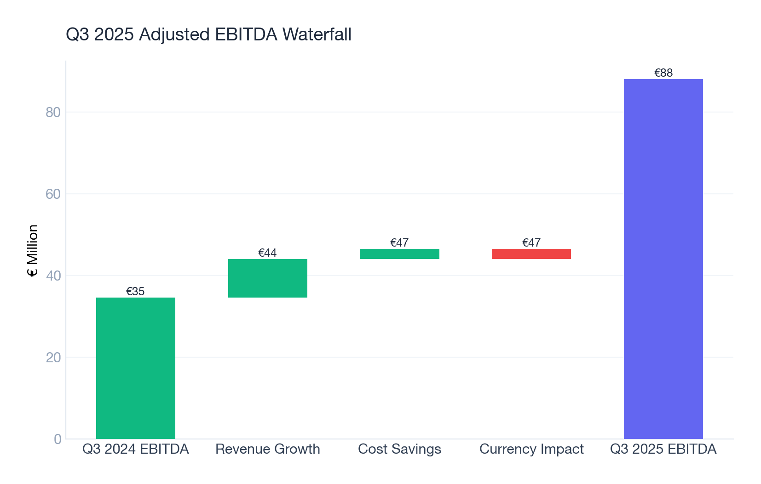
Financial Breakdown: Adjusted EBITDA Growth
KEY INSIGHTS
Adjusted EBITDA up 27.2% YoY
6 / 11
Notes:
The waterfall chart illustrates the components driving the increase in Adjusted EBITDA, including revenue growth and cost savings.

Slide 7
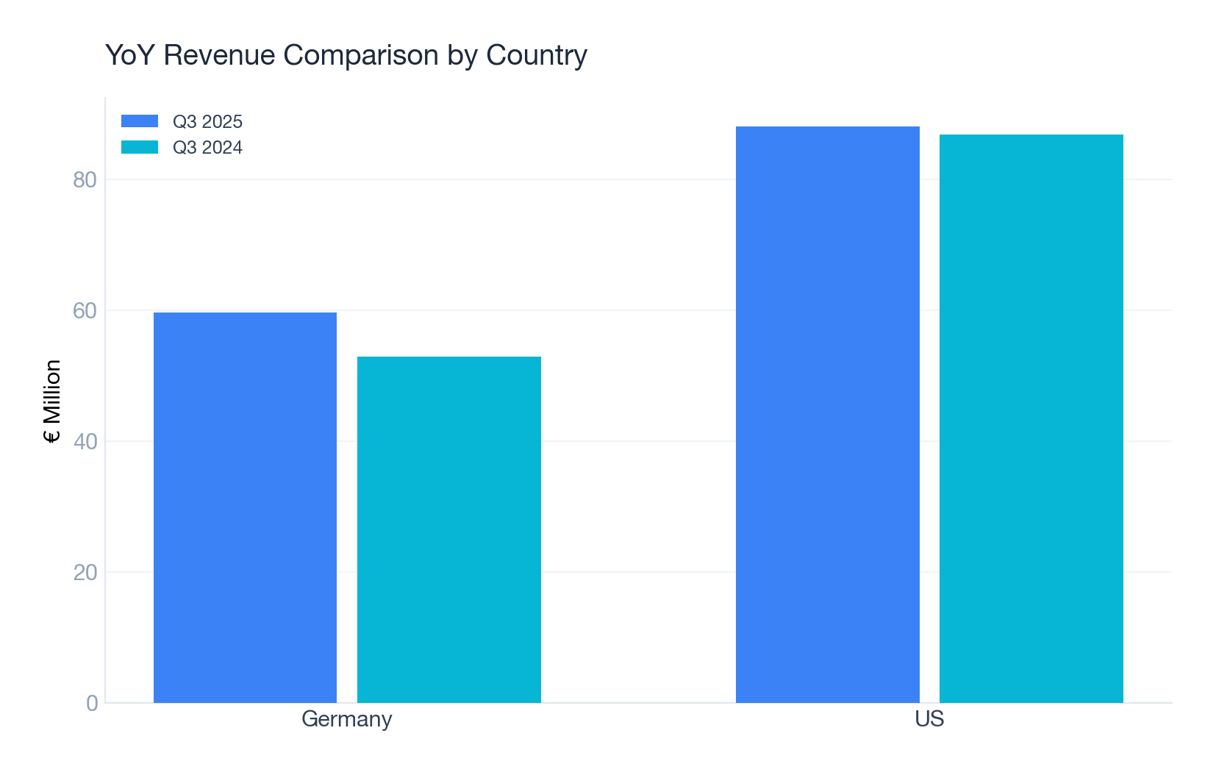
YoY Revenue Comparison by Country
KEY INSIGHTS
Germany shows 12.9% growth
7 / 11
Notes:
Germany led the growth among countries, reflecting strong performance in the European market.

Slide 8
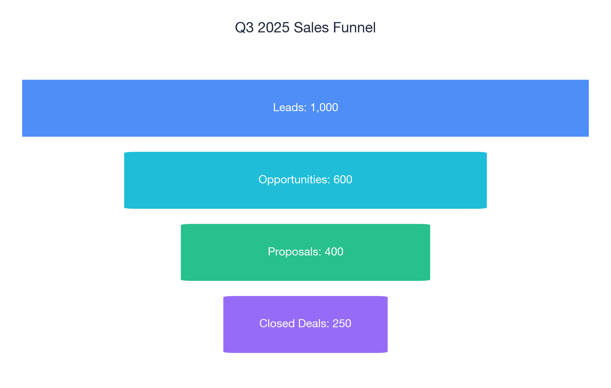
Sales Pipeline: Conversion Efficiency
KEY INSIGHTS
High conversion rate in Q3
8 / 11
Notes:
The funnel chart demonstrates our sales conversion efficiency, with a strong closure rate in Q3 2025.

Slide 9
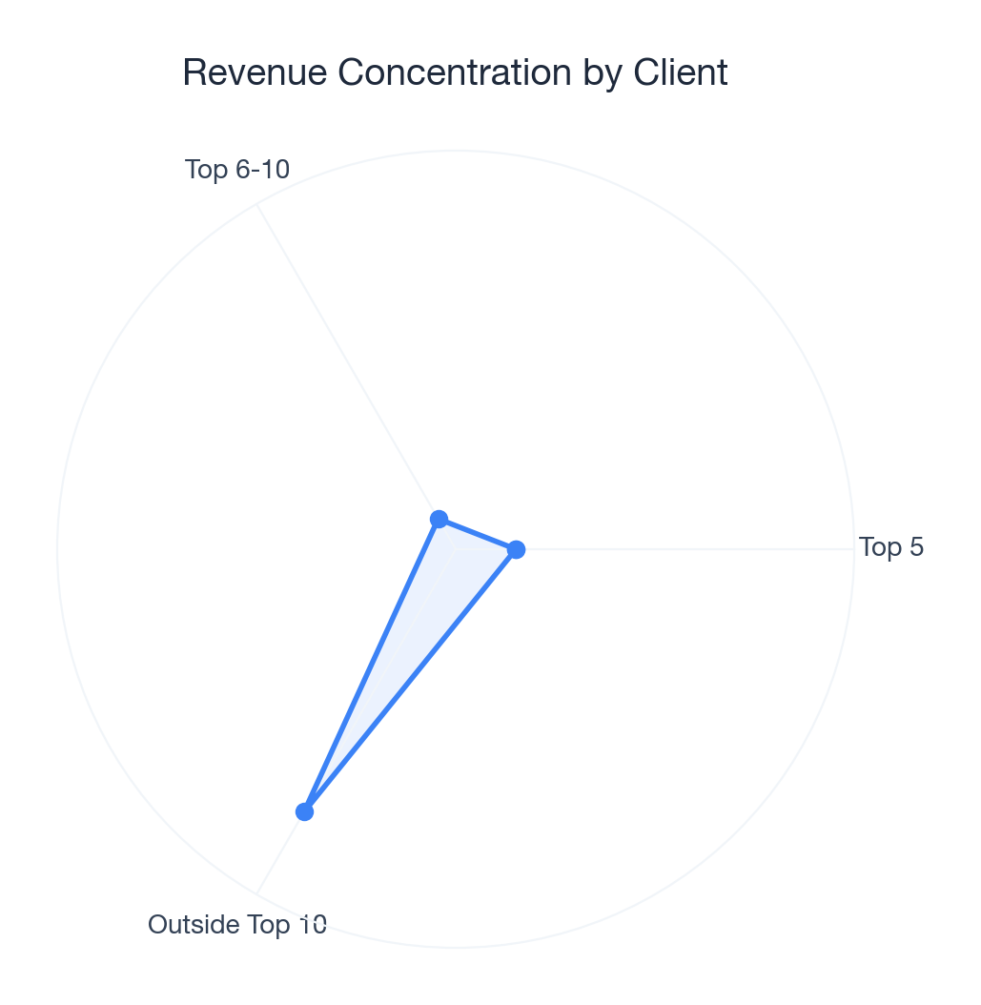
Revenue Concentration: Client Diversification
KEY INSIGHTS
Top 5 clients: 15.1% of revenue
9 / 11
Notes:
Our revenue remains well-diversified, with a balanced client portfolio mitigating risk.

Slide 10
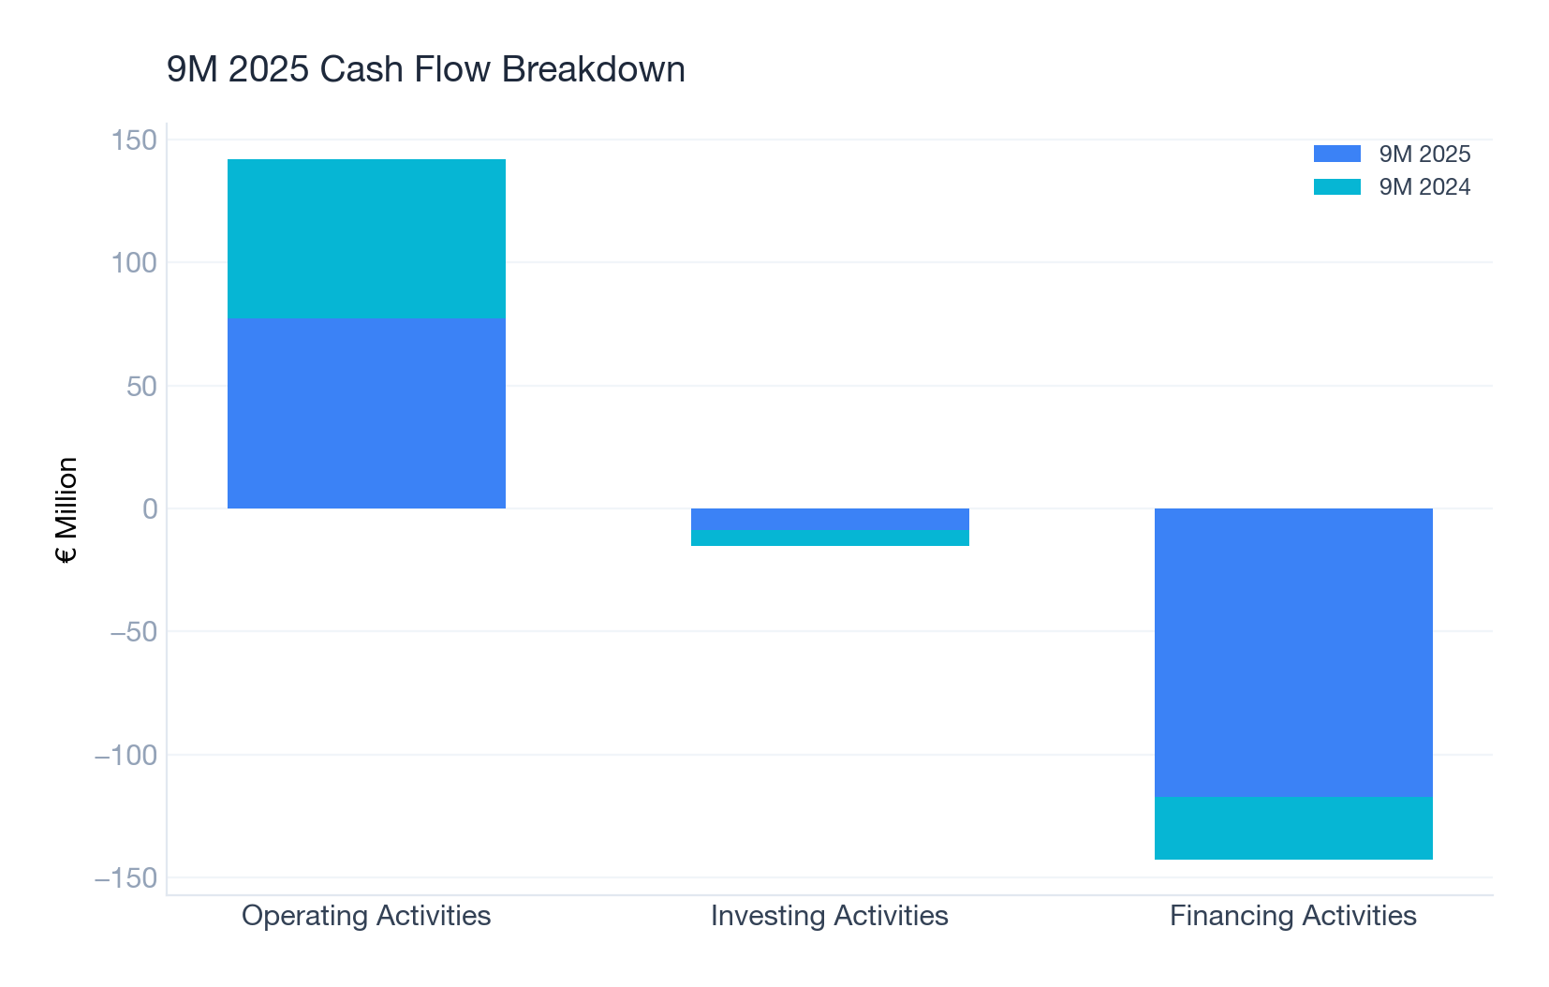
Cash Flow Analysis: Strong Operating Cash Flow
KEY INSIGHTS
Operating cash flow up €12.2M
10 / 11
Notes:
The chart highlights our robust operating cash flow, despite increased financing outflows related to strategic investments.

Slide 11
Strategic Recommendations
11 / 11
Notes:
To sustain growth, we recommend focusing on high-growth industries, enhancing client diversification, and leveraging AI transformation opportunities.

